Slide 1

West Nile Virus Prevention
Group members:
Elise, Fadhil, Prerak, Shandeep

Slide 2
01
02
INTRODUCTION
EDA & MODELS
03
04
COST - BENEFIT
ANALYSIS
DEPLOYMENT
05
LIMITATIONS AND FUTURE STEPS

Slide 3
01
INTRODUCTION

Slide 4
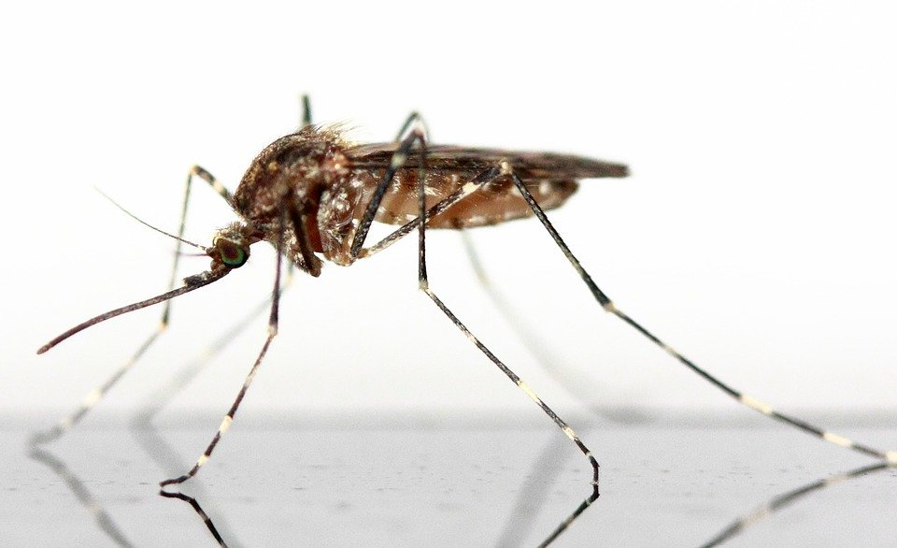
West Nile Virus
West Nile Virus is a mosquito-borne disease that has plagued continental United States since 1999. About 1 in 150 infected people develop a serious illness, which could lead to fatality. Currently, there is no vaccine available to treat WNV.

Slide 5
Introduction
PROBLEM STATEMENT
CONTEXT
SCOPE
- Predict locations with potential of being infested with mosquitoes carrying WNV
- Explore factors contributing to the growth and spread of the virus through mosquitoes
The Chicago Department of Public Health (CDPH) has set up a surveillance and control system to trap mosquitoes and test for the presence of WNV. Current research highlights that increases in WNV infection rates in mosquito populations could serve as an indicator of a potential outbreak in humans. Aggressive and timely interventions could therefore curb the spread of the virus.
- Derive a plan to deploy pesticides throughout the city of Chicago
- Employ various modelling techniques to help guide decisions in order to maximise pesticide effectiveness and minimise costs

Slide 6
02
EDA & MODELS

Slide 7
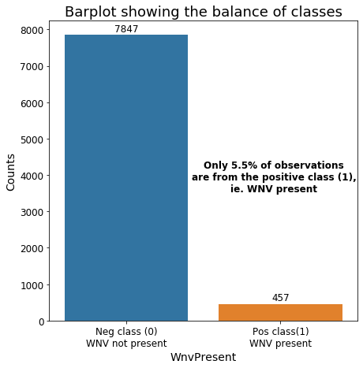
IMBALANCED CLASSES

Slide 8
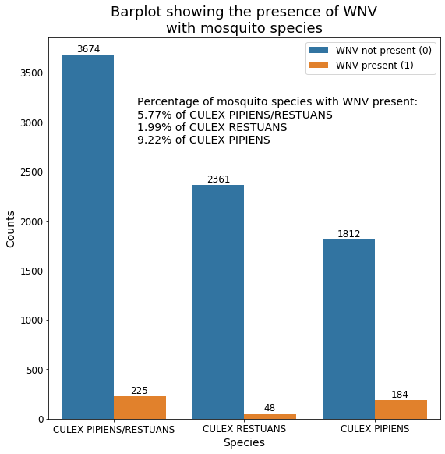
CULPRIT MOSQUITO SPECIES

Slide 9
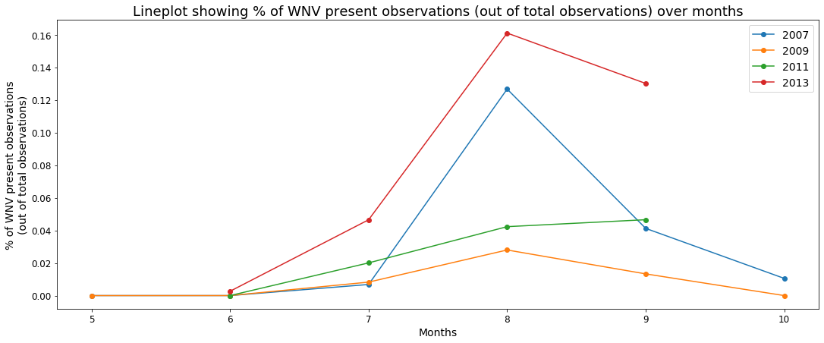
WNV BY MONTHS

Slide 10
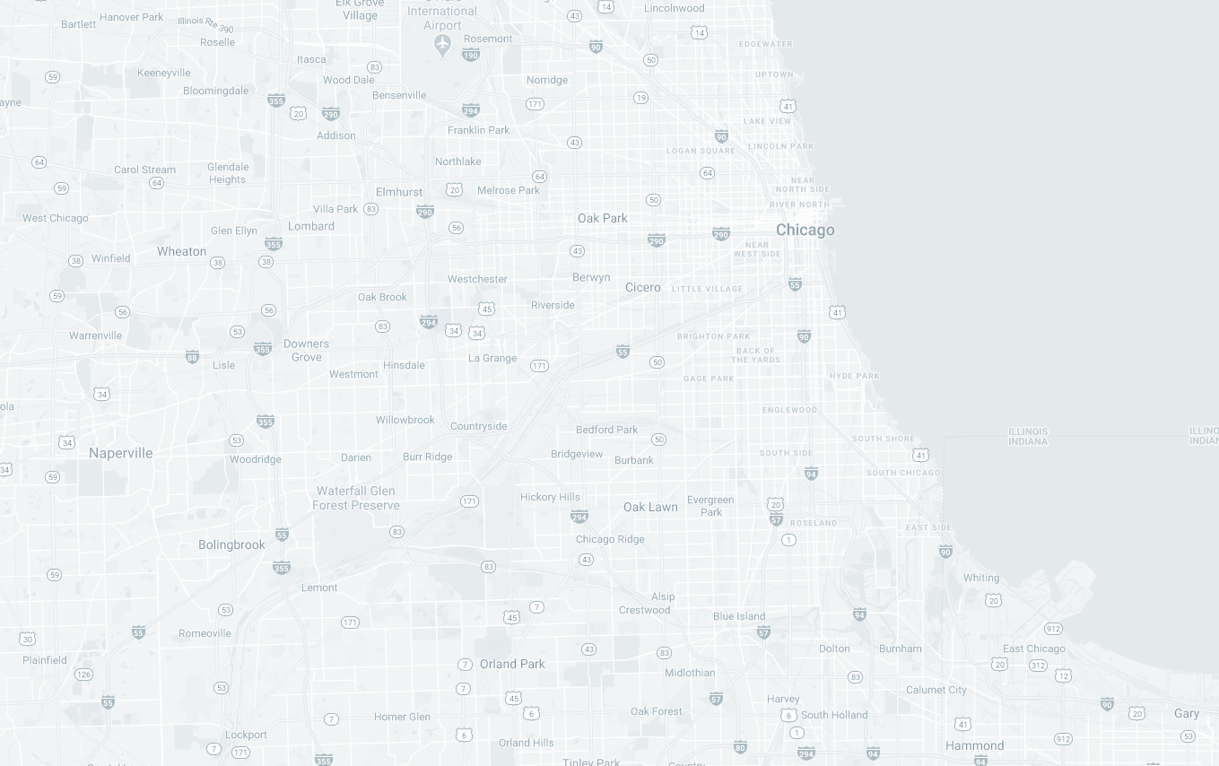

FEATURE ENGINEERING
= spray done within last 7 days
Sprayed
Assumptions made:
Spraying is effective for up to 7 days.
Spraying is effective in a ~100m radius from the location of spraying.
Sprayed = 1 if assumptions are satisfied, 0 otherwise.
Sprayed = 1
~100m radius

Slide 11
FEATURE ENGINEERING
= WNV not present (0)
= WNV present (1)
~2mil (3.2km) radius
Average Positive Distance
Average distance of previously positively tested mosquito traps from each individual trap being tested.
Accounts for spatial correlation between mosquito traps.
The closer these previously positively tested traps are, the higher the chances that mosquitoes could have flown over and brought the virus with them (and vice-versa).
Assumption: mosquitoes fly ~2mil (3.2km) on average.

Slide 12
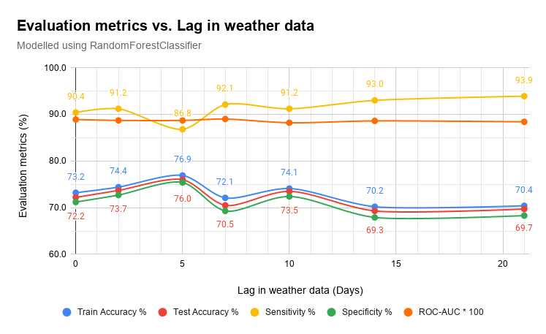
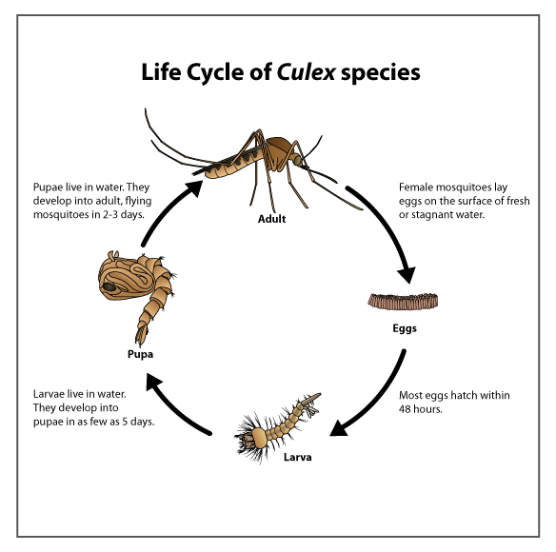
WEATHER DATA LAG
Lag = 10 days
If today’s weather is ideal for mosquito breeding, they lay more eggs than usual.
Eggs will grow into adult mosquitoes over 10 days.
Only after 10 days will we see an increase in the presence of WNV in the mosquito traps.

Slide 13
CLASSIFICATION MODELLING SUMMARY
Classifier | Class Balancing Technique | Accuracy on training set | Accuracy on testing set | Sensitivity (Recall) | Specificity | ROC-AUC | Kaggle ROC-AUC
LogisticRegression | SMOTE | 70.7% | 71.2% | 85.1% | 70.4% | 0.858 | 0.661
RandomForestClassifier | SMOTE | 77.8% | 77.5% | 85.1% | 77.1% | 0.872 | 0.706
SVC | SMOTE | 70.3% | 69.4% | 86.0% | 68.4% | 0.844 | 0.675
GradientBoostingClassifier | SMOTE | 78.0% | 76.5% | 83.3% | 76.1% | 0.871 | 0.705

Slide 14
CLASSIFICATION MODELLING SUMMARY
Classifier | Class Balancing Technique | Accuracy on training set | Accuracy on testing set | Sensitivity (Recall) | Specificity | ROC-AUC | Kaggle ROC-AUC
LogisticRegression | SMOTE | 70.7% | 71.2% | 85.1% | 70.4% | 0.858 | 0.661
RandomForestClassifier | SMOTE | 77.8% | 77.5% | 85.1% | 77.1% | 0.872 | 0.706
SVC | SMOTE | 70.3% | 69.4% | 86.0% | 68.4% | 0.844 | 0.675
GradientBoostingClassifier | SMOTE | 78.0% | 76.5% | 83.3% | 76.1% | 0.871 | 0.705

Slide 15
CLASSIFICATION MODELLING SUMMARY
Classifier | Class Balancing Technique | Accuracy on training set | Accuracy on testing set | Sensitivity (Recall) | Specificity | ROC-AUC | Kaggle ROC-AUC
LogisticRegression | SMOTE | 70.7% | 71.2% | 85.1% | 70.4% | 0.858 | 0.661
RandomForestClassifier | SMOTE | 77.8% | 77.5% | 85.1% | 77.1% | 0.872 | 0.706
SVC | SMOTE | 70.3% | 69.4% | 86.0% | 68.4% | 0.844 | 0.675
GradientBoostingClassifier | SMOTE | 78.0% | 76.5% | 83.3% | 76.1% | 0.871 | 0.705
RandomForestClassifier | ADASYN | 77.1% | 76.2% | 84.2% | 75.7% | 0.872 | 0.713
RandomForestClassifier | ClusterCentroids | 62.7% | 62.4% | 92.1% | 60.7% | 0.848 | 0.707
RandomForestClassifier | class_weight = ‘balanced_subsample’ | 74.1% | 73.5% | 91.2% | 72.4% | 0.882 | 0.717

Slide 16
CLASSIFICATION MODELLING SUMMARY
Classifier | Class Balancing Technique | Accuracy on training set | Accuracy on testing set | Sensitivity (Recall) | Specificity | ROC-AUC | Kaggle ROC-AUC
LogisticRegression | SMOTE | 70.7% | 71.2% | 85.1% | 70.4% | 0.858 | 0.661
RandomForestClassifier | SMOTE | 77.8% | 77.5% | 85.1% | 77.1% | 0.872 | 0.706
SVC | SMOTE | 70.3% | 69.4% | 86.0% | 68.4% | 0.844 | 0.675
GradientBoostingClassifier | SMOTE | 78.0% | 76.5% | 83.3% | 76.1% | 0.871 | 0.705
RandomForestClassifier | ADASYN | 77.1% | 76.2% | 84.2% | 75.7% | 0.872 | 0.713
RandomForestClassifier | ClusterCentroids | 62.7% | 62.4% | 92.1% | 60.7% | 0.848 | 0.707
RandomForestClassifier | class_weight = ‘balanced_subsample’ | 74.1% | 73.5% | 91.2% | 72.4% | 0.882 | 0.717

Slide 17
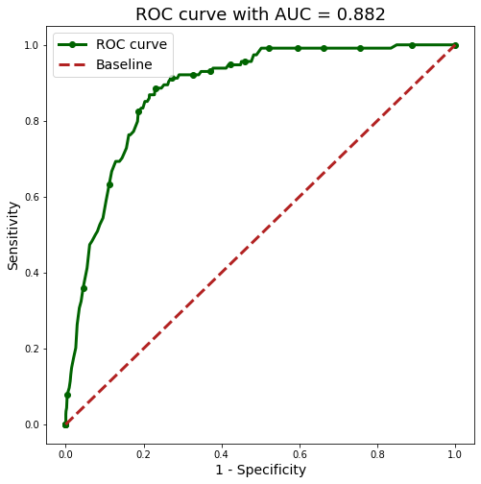
CLASSIFICATION MODELLING SUMMARY
Confusion Matrix | Actual WNV present (1) | Actual WNV not present (0)
Predicted WNV present (1) | 104 (TP) | 541 (FP)
Predicted WNV not present (0) | 10 (FN) | 1421 (TN)

Slide 18
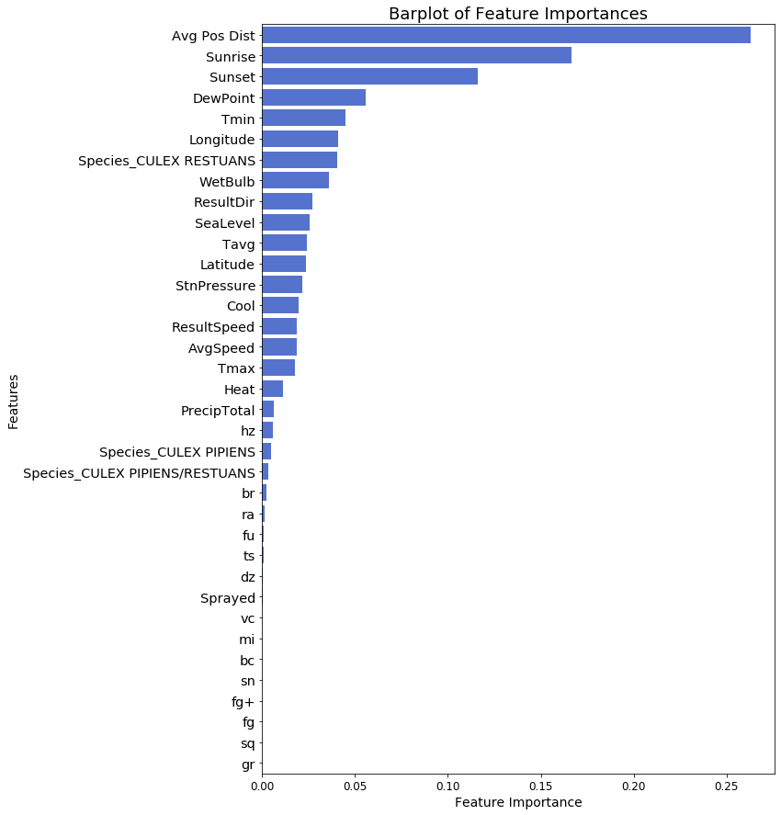
FEATURE IMPORTANCE
 | RFC without Avg Pos Dist | RFC with Avg Pos Dist
Accuracy on training set | 66.2% | 73.2%
Accuracy on testing set | 65.8% | 72.2%
Sensitivity (Recall) | 90.4% | 90.4%
Specificity | 64.3% | 71.2%
ROC-AUC | 0.855 | 0.889
Kaggle ROC-AUC | 0.710 | 0.722

Slide 19
03
COST - BENEFIT ANALYSIS

Slide 20


Cost of Spraying
The insecticide that we recommend is Zenivex(tested and proven pesticide).
- Price/fluid ounce is $22,948.75 / 35200 = $0.65
- 1.5 oz cost/acre = $0.65 * 1.5 = $0.97/acre
- spray location in sqm = 3.14 * (100m**2) = 31,400sqm
- 1 acre = 4046.86sqm
1 spray location = $0.97 * (31400/4046.86) = $7.52
On average, based on our model prediction
Total Spraying Cost:
$52,767 per year
(excl. overhead costs)
*The calculations above are based on our model built on 8304 readings.

Slide 21




Benefit of Spraying
Based on Sacramento data, 163 reported cases incurred ≈ USD2.28 million in medical treatment.
Assuming the same infection rate and population density in Chicago,
There would be 511 reported cases of WNV.
This would incur $573,342 in medical treatment
*given the best case scenario of all reported cases being WNF
$573,342 > $52,767
Medical Costs per Person:
WNND:
Mild Cases: $76,31
Severe Cases: $33,143
Productivity Loss: $10,800
WNF:
Medical Cost: $167
Productivity Loss: $955
(Source: NCBI https://www.ncbi.nlm.nih.gov/pmc/articles/PMC3322011/)

Slide 22
Prevention is better than Cure!
Steps that can be taken to curb the virus:
Education and Programs on West Nile Virus
Campaigns to reduce and curb mosquito population
Monetary enforcement (i.e fines) against mosquito breeding in households
Utilise the model country-wide for spray locations

Slide 23
04
DEPLOYMENT
DEMO TIME!

Slide 24
05
LIMITATION AND FUTURE STEPS

Slide 25
LIMITATIONS
IMBALANCE DATA
LOW ACCURACY
DEPLOYMENT
OVERHEAD COSTS
Insufficient information on the positive class resulted in low accuracy
Had to compromise accuracy to minimise false negatives
Not easily accessible by users and limited information
Unable to get a good estimate of overhead costs

Slide 26
FUTURE STEPS
DATA COLLECTION
DEPLOYMENT
Compile data from other states
Collect more future data
Deploy our model to cloud for convenient access
Provide more information
Improve the interface

Slide 27
Thank you!
Please keep this slide for attribution.
Elise, Fadhil, Prerak, Shandeep

